Slide 1
Chapter 8: Modifiability
It is not the strongest of the species that survive, nor the most intelligent, but the one most responsive to change. —Charles Darwin

Slide 2
Chapter Outline
What is Modifiability?
Modifiability General Scenario
Tactics for Modifiability
Tactics-Based Questionnaire for Modifiability
Patterns for Modifiability
Summary

Slide 3
What is Modifiability?
Modifiability is about change and our interest in it is in the cost and risk of making changes.
To plan for modifiability, an architect has to consider three questions:
What can change?
What is the likelihood of the change?
When is the change made and who makes it?

Slide 4
What is Modifiability?
For N similar modifications, a simplified justification for a change mechanism is that
N * Cost of making change without the mechanism ≤
Cost of creating the mechanism + (N * cost of making the change using the mechanism)

Slide 5
What is Modifiability?
Change is so prevalent in the life of software systems that special names have been given to specific flavors of modifiability.
Some of the common ones are:
Scalability
Variability
Portability
Location independence

Slide 6
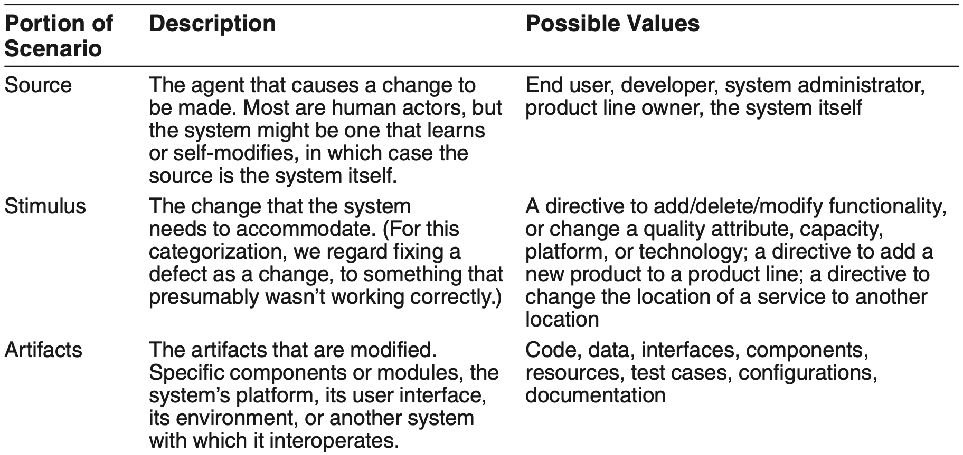
Modifiability General Scenario

Slide 7
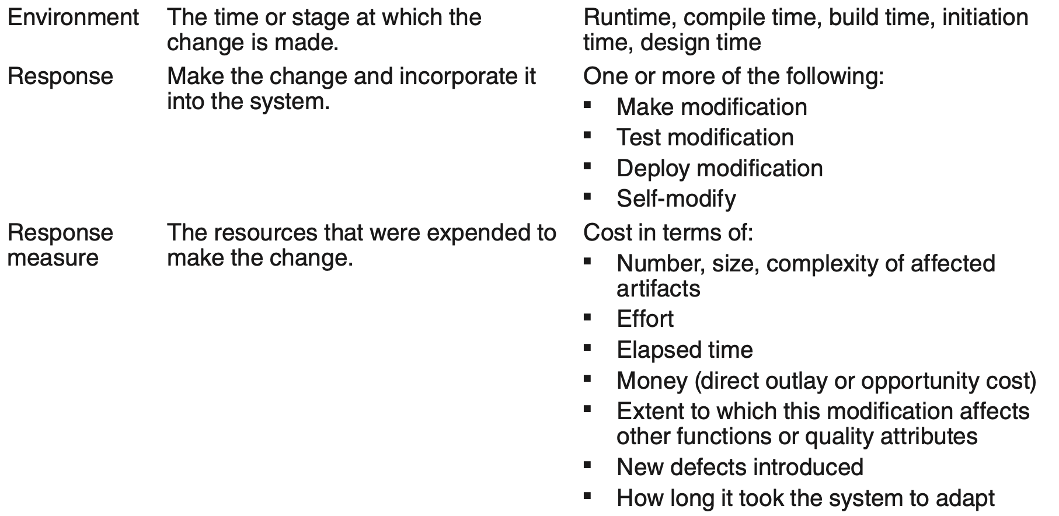
Modifiability General Scenario

Slide 8
Sample Concrete Modifiability Scenario
A developer wishes to change the user interface. This change will be made to the code at design time, it will take less than three hours to make and test the change, and no side effects will occur.

Slide 9
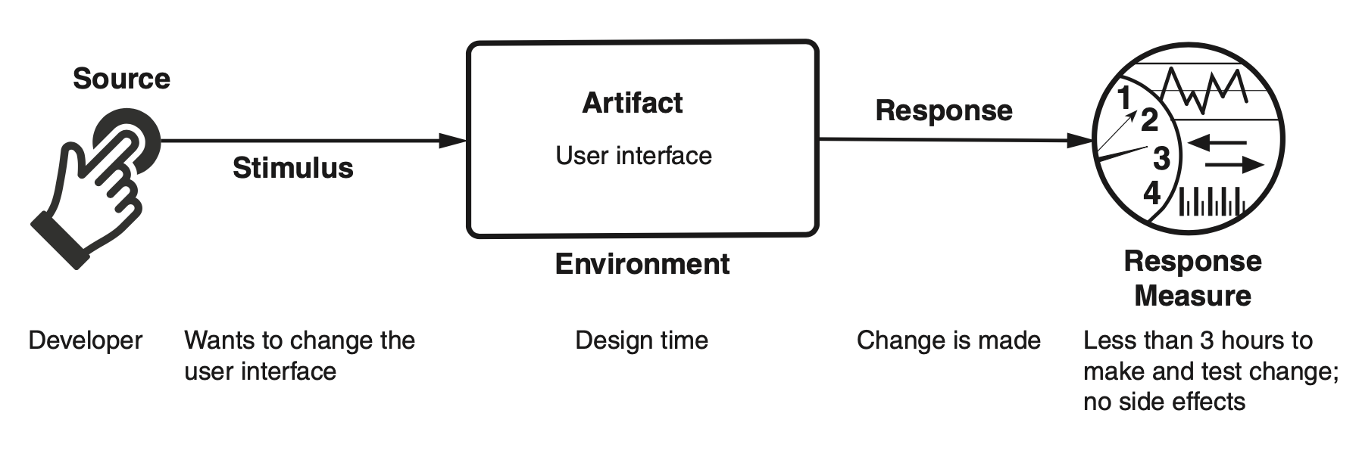
Sample Concrete Modifiability Scenario

Slide 10
Goal of Modifiability Tactics
Tactics to control modifiability have as their goal controlling the complexity of making changes, as well as the time and cost to make changes.

Slide 11
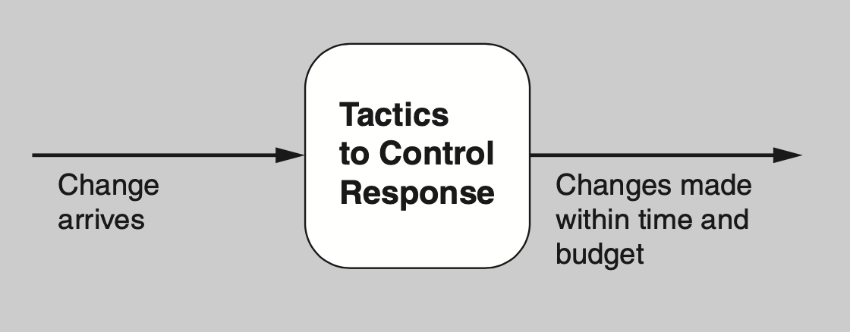
Goal of Modifiability Tactics

Slide 12
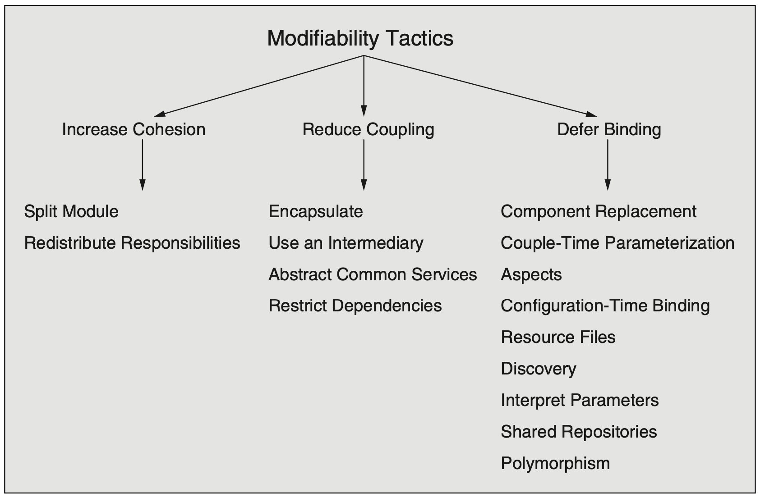
Modifiability Tactics

Slide 13
Increase Cohesion
Split Module. If the module being modified includes responsibilities that are not cohesive, the modification costs will likely be high. Refactoring the module into several more cohesive modules should reduce the average cost of future changes.
Redistribute responsibilities. If responsibilities A, A', and A'' are sprinkled across several distinct modules, they should be placed together. This refactoring may involve creating a new module, or it may involve moving responsibilities to existing modules.

Slide 14
Reduce Coupling
Encapsulate. See Chapter 7.
Use an intermediary. See Chapter 7.
Abstract common services. See Chapter 7.
Restrict dependencies. This tactic restricts which modules a given module interacts with or depends on. In practice, this tactic is implemented by restricting a module’s visibility (when developers cannot see an interface, they cannot employ it) and by authorization (restricting access to only authorized modules).

Slide 15
Defer Binding
The following tactics can be used to bind values at compile time or build time:
Component replacement
Compile-time parameterization
Aspects
The following tactics bind values at deployment, startup time, or initialization time:
Configuration-time binding
Resource files
Tactics to bind values at runtime include the following:
Discovery (see Chapter 7)
Interpret parameters
Shared repositories
Polymorphism

Slide 16
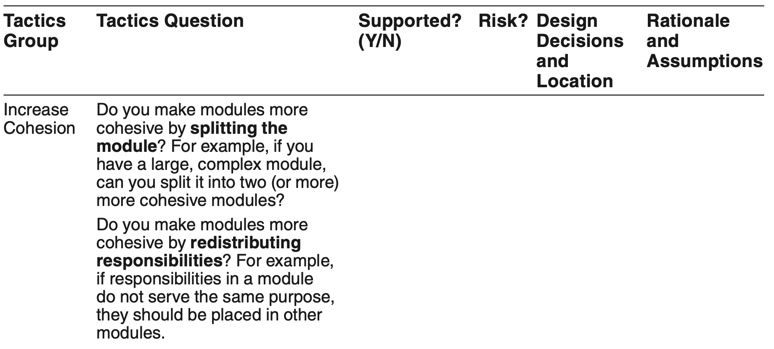
Tactics-Based Questionnaire for Modifiability

Slide 17
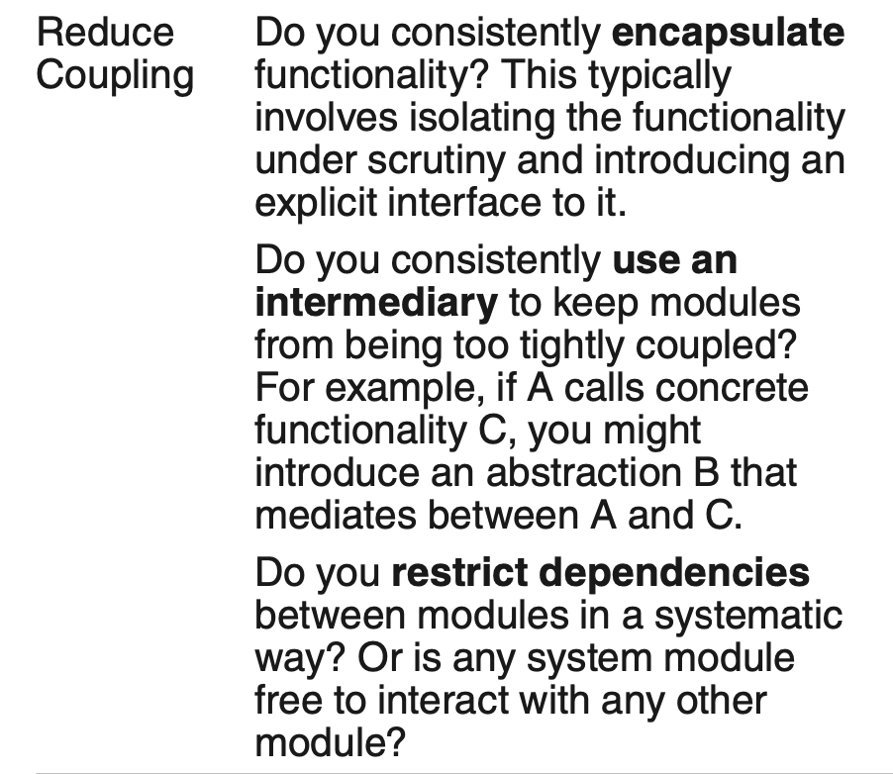
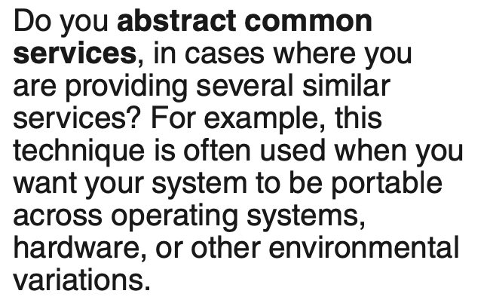
Tactics-Based Questionnaire for Modifiability

Slide 18
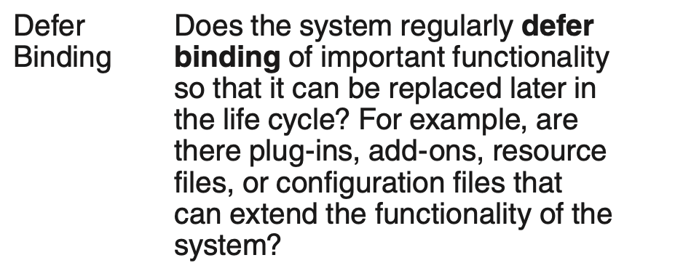
Tactics-Based Questionnaire for Modifiability

Slide 19
Client-Server Pattern for Modifiability
The client-server pattern consists of a server providing services simultaneously to multiple distributed clients. The most common example is a web server providing information to multiple simultaneous users of a website.

Slide 20
Client-Server Pattern Benefits
Benefits:
The connection between a server and its clients is established dynamically. The server has no a priori knowledge of its clients—that is, there is low coupling between the server and its clients.
There is no coupling among the clients.
The number of clients can easily scale and is constrained only by the capacity of the server. The server functionality can also scale if its capacity is exceeded.
Clients and servers can evolve independently.
Common services can be shared among multiple clients.
The interaction with a user is isolated to the client.

Slide 21
Client-Server Pattern Tradeoffs
Tradeoffs:
This pattern is implemented such that communication occurs over a network, perhaps even the Internet. Thus messages may be delayed by network congestion, leading to degradation (or at least unpredictability) of performance.
For clients that communicate with servers over a network shared by other applications, special provisions must be made for achieving security (especially confidentiality) and maintaining integrity.

Slide 22
Plug-in (Microkernel) Pattern for Modifiability
The plug-in pattern has two types of elements:
core elements, that provide a core set of functionality
plug-ins, that add functionality to the core via a fixed set of interfaces.
The two types are typically bound together at build time or later.

Slide 23
Plug-in (Microkernel) Pattern Benefits
Plug-ins provide a controlled mechanism to extend a core product and make it useful in a variety of contexts.
The plug-ins can be developed by different teams or organizations than the developers of the microkernel. This allows for the development of two different markets: for the core product and for the plug-ins.
The plug-ins can evolve independently from the microkernel (as long as the interfaces do not change).

Slide 24
Plug-in (Microkernel) Pattern Tradeoffs
Because plug-ins can be developed by different organizations, it is easier to introduce security vulnerabilities and privacy threats.

Slide 25
Layers Pattern for Modifiability
The layers pattern divides the system in such a way that the modules can be developed and evolved separately with little interaction among the parts, which supports portability, modifi- ability, and reuse.
To achieve this separation of concerns, the layers pattern divides the software into units called layers. Each layer is a grouping of modules that offers a cohesive set of services.
The allowed-to-use relationship among the layers is subject to a key constraint: The relations must be unidirectional.
Layers completely partition a set of software, and each partition is exposed through a public interface.

Slide 26
Layers Pattern Benefits
Because a layer is constrained to use only lower layers, software in lower layers can be changed (as long as the interface does not change) without affecting the upper layers.
Lower-level layers may be reused across different applications.
Because the allowed-to-use relations are constrained, the number of interfaces that any team must understand is reduced.

Slide 27
Layers Pattern Tradeoffs
If the layering is not designed correctly, it may actually get in the way, by not providing the lower-level abstractions that programmers at the higher levels need.
Layering often adds a performance penalty to a system. If a call is made from a function in the top-most layer, it may have to traverse many lower layers before being executed by the hardware.
If many instances of layer bridging occur, the system may not meet its portability and modifiability goals, which strict layering helps to achieve.

Slide 28
Publish-Subscribe Pattern for Modifiability
Publish-subscribe is an architectural pattern in which components communicate primarily through asynchronous messages, sometimes referred to as “events” or “topics.”
The publishers have no knowledge of the subscribers, and subscribers are only aware of message types.
At runtime, when a message is published, the publish–subscribe (or event) bus notifies all of the elements that registered an interest in the event or topic.
The result is loose coupling between the publishers and the subscribers.
The publish-subscribe pattern has three types of elements:
Publishers
Subscribers
Event bus

Slide 29
Publish-Subscribe Pattern Benefits
Publishers and subscribers are independent and hence loosely coupled. Adding or changing subscribers requires only registering for an event and causes no changes to the publisher.
System behavior can be easily changed by changing the event or topic of a message being published, and consequently which subscribers might receive and act on this message.
Events can be logged easily to allow for record and playback.

Slide 30
Publish-Subscribe Pattern Tradeoffs
Some implementations of the publish-subscribe pattern can negatively impact per- formance (latency). Use of a distributed coordination mechanism will ameliorate the performance degradation.
In some cases, a component cannot be sure how long it will take to receive a published message. In general, system performance and resource management are more difficult to reason about in publish-subscribe systems.
Use of this pattern can negatively impact determinism. The order in which methods are invoked, as a result of an event, may vary.
Use of the publish-subscribe pattern can negatively impact testability. Seemingly small changes in the event bus can have a wide impact on system behavior and quality of service.
Some publish-subscribe implementations limit the mechanisms available to implement security (integrity). Since publishers do not know the identity of subscribers, and vice versa, end-to-end encryption is limited. Messages from a publisher to the event bus can be encrypted, and messages from the event bus to a subscriber can be encrypted; but end-to-end encrypted communication requires all publishers and subscribers to share the same key.

Slide 31
Summary
Modifiability deals with change and the cost in time or money of making a change, including the extent to which this modification affects other functions or quality attributes.
Tactics to reduce the cost of making a change include making modules smaller, increasing cohesion, and reducing coupling. Deferring binding will also reduce the cost of making a change.

